Slide 1
Status Report: Signals and Systems
Armin Gholampoor • 1399.11.14

Slide 2
Overview
Consists of 1 main file and 3 function files.
Main file creates noisy, clean, and echoed files. It also saves original voice in original.wav.
Add_echo adds echo to audio(!) and saves it in echo.wav.
Make_noisy adds noise to audio and saves it in noisy.wav.
Remove_noise removes the noise from noisy.wav and saves it in clean.wav.

Slide 3
Main
clean=remove_noise(y, noisy);
audiowrite('clean.wav',clean,fs);
Nn=length(clean);
Fn=(-Nn/2:Nn/2-1)/Nn;
Fq=fs*Fn;
qa=fft(clean);
qa=fftshift(qa);
plot(Fq,qa); title('Clean frequency');
subplot(5,1,4);
N1=length(noisy);
Fa=(-N1/2:N1/2-1)/N1;
F1=Fa*fs;
xa=fft(noisy);
xa=fftshift(noisy);
plot(F1,xa) ;title('Noisy frequency');
subplot(5,1,5);
recObj = audiorecorder;
disp('Speak');
recordblocking(recObj, 7);
disp('Stop');
%play(recObj);
y = getaudiodata(recObj);
%y = audioread('original.wav');
plot(y);
fs=0.80E+4;
audiowrite('original.wav',y,fs);
amp=0.4;
delay=0.25;
echo=add_echo(y, fs, delay, amp);
audiowrite('echo.wav',echo,fs);
noisy=make_noisy(y, fs);
audiowrite('noisy.wav',noisy,fs);
subplot(5,1,3)
N=length(y);
Fc=(-N/2:N/2-1)/N;
F=fs*Fc;
we=fft(y);
we=fftshift(we);
plot(F,we); title('Original frequency');
subplot(5,1,5);

Slide 4
add_echo
function echo = add_echo(input, fs, delay, amp)
%ADD_ECHO Summary of this function goes here
% Detailed explanation goes here
sr = round(fs*delay);
org = [input; zeros(sr,1)];
effect = [zeros(sr,1); input*amp];
echo = org + effect;
norm = max(abs(echo));
if norm > 1
echo = echo./norm;
end

Slide 5
make_noisy
function noisy = make_noisy(y,fs)
%MAKE NOISY Summary of this function goes here
% Detailed explanation goes here
noisy = y + 2*randn(length(y),1);
time=(1/fs)*length(y);
t=linspace(0,time,length(y)) ;
subplot(5,1,1);
plot(t,y);
title('Original Time');
subplot(5,1,2)
time1=(1/fs)*length(noisy);
t1=linspace(0,time1,length(noisy));
plot(t1,noisy);
title('Noisy time');
end

Slide 6
remove_noise
function clean = remove_noise(y, noisy)
%REMOVE_NOISE Summary of this function goes here
% Detailed explanation goes here
i=1;
for j=2:length(noisy)-1
y(j,i) = (y(j-1,i) + y(j,i) + y(j+1,i))/3 ;
end
g = gausswin(20);
g = g/sum(g);
y= conv(y(:,1), g, 'same');
result=sgolayfilt(y,1,17);
clean=result;
end

Slide 7
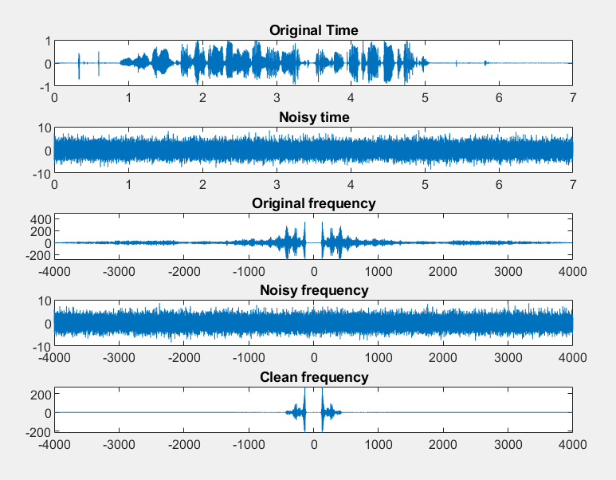
plots

